Slide 1
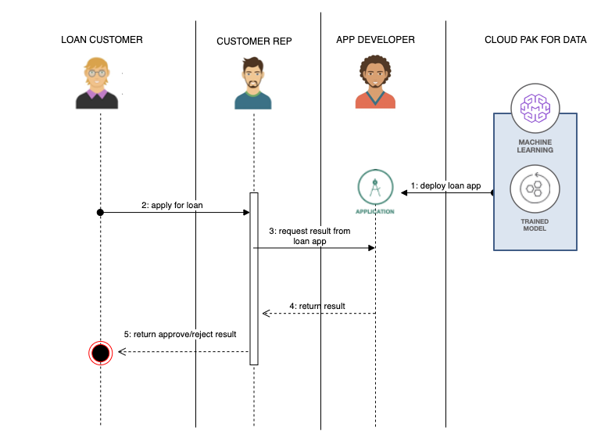
Idea-1 for loan approval

Slide 2
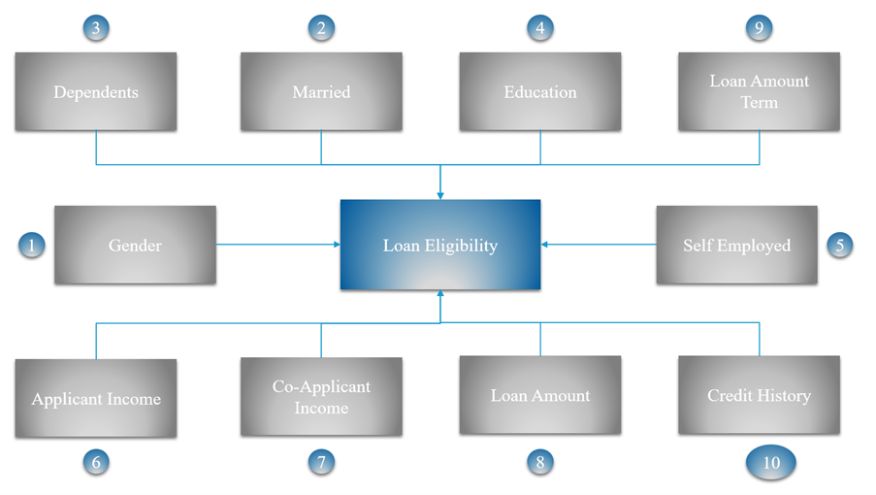
Idea-2 for loan Approval

Slide 3
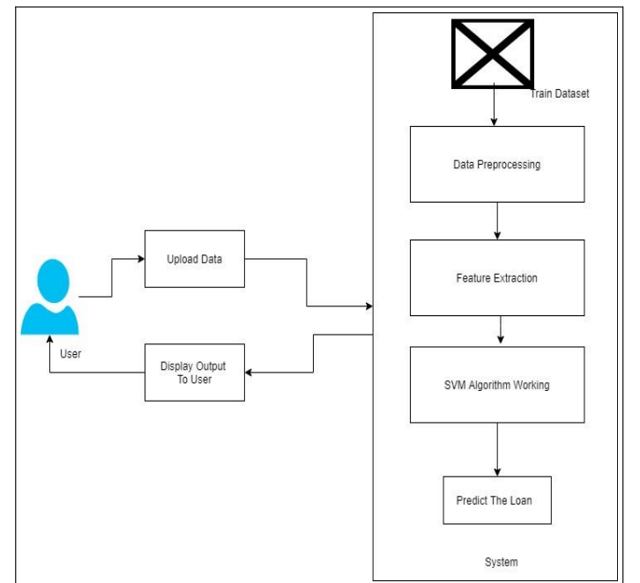
Idea-3 For Loan Approval

